Slide 1


Slide 2
History of HTML
1991
HTML first published
1995
HTML 2.0
After HTML 4.01 was released, focus shifted to XHTML and its stricter standards.
1997
HTML 3.2
1999
HTML 4.01
XHTML 2.0 had even stricter standards than 1.0, rejecting web pages that did not comply. It fell out of favor gradually and was abandoned completely in 2009.
2000
XHTML 1.0
2002 -2009
HTML5 is much more tolerant and can handle markup from all the prior versions.
XHTML 2.0
HTML5
Though HTML5 was published officially in 2012, it has been in development since 2004.
2012

Slide 3
What is HTML
HTML describes the structure of Web pages using markup
HTML elements are the building blocks of HTML pages
HTML elements are represented by tags
Each tag contains a set of attributes
HTML tags label pieces of content such as "heading", "paragraph", "table", and so on
Browsers do not display the HTML tags, but use them to render the content of the page

Slide 4
HTML: Example
<!DOCTYPE html> <html> <head> <title>Page Title</title> </head> <body> <h1>My First Heading</h1> <img src=“hello.jpng" width=“150" height="150">
<p>My first paragraph.</p> </body> </html>
!DOCTYPE
document being rendered is an HTML document

Slide 5
HTML: Attributes
Attribute come in name/value pair e.g. name=“value”
Examples
<img src=“hello.jpng" width="150" height=“150">
<a href=http://www.google.com>Search</a>
<div id=“head-wrapper”></d>
src | Specifies the URL for image
width | Specifies the width of image
id | Defines the unique identifier for the element
href | Specifies the URL for element

Slide 6
What is XHTML
XHTML stands for EXtensible HyperText Markup Language
According to the W3C, "XHTML 1.0 is a reformulation of HTML 4.01 in XML, and combines the strength of HTML 4 with the power of XML
XHTML is almost identical to HTML
XHTML is stricter than HTML
By combining the strengths of HTML and XML, XHTML was developed.

Slide 7
What is XHTML
a doctype indicator must be included in all documents
tag names must be in lowercase
all documents must be properly structured
all tags must be properly nested
all tags must be closed
all attributes must be quoted
the <title> tag must come first in the <head> tag.

Slide 8
Why XHTML
Many pages on the internet contain "bad" HTML.
This HTML code works fine in most browsers (even if it does not follow the HTML rules):
<html> <head> <title>This is bad HTML</title> (missing </head>) <body> <h1>Bad HTML (missing </h1>) <p>This is a paragraph </body>

Slide 9
XHTML Document
A glance at an XHTML document would basically look just like one coded in HTML 4.01:
<?xml version="1.0" encoding="UTF-8"?>
<!DOCTYPE html PUBLIC "-//W3C//DTD XHTML 1.0 Transitional//EN" "http://www.w3.org/TR/xhtml1/DTD/xhtml1-transitional.dtd">
<html xmlns="http://www.w3.org/1999/xhtml">
<head>
<title>Basic Document</title>
</head>
<body>
<p>Every good boy does well.</p>
</body>
</html>

Slide 10
What is XML
XML stands for EXtensible Markup Language
XML was designed to store and transport data
XML was designed to be both human- and machine-readable

Slide 11
XML: Example
<?xml version="1.0" encoding="UTF-8"?> <note> <to>Student</to> <from>Teaher</from> <heading>Reminder</heading> <body>Project Submission!</body> </note>

Slide 12
HTML5: Introduction
HTML5 will be the new standard for HTML, XHTML, and the HTML DOM (document object model).
HTML5 is still a work in progress, but most modern browsers have some HTML5 support.
It incorporates all features from earlier versions of HTML, including the stricter XHTML.
One of the main advantages of HTML5 is that web page can be structured in such a way that can help the readers or search engine bots about the contents of the page and target the desired part on the page.

Slide 13
HTML5: Introduction
Support all existing web pages. With HTML5, there is no requirement to go back and revise older websites.
Reduce the need for external plugins and scripts to show website content.
Improve the semantic definition (i.e. meaning and purpose) of page elements.
Make the rendering of web content universal and independent of the device being used (HTML5 is cross-platform)
Handle web documents errors in a better and more consistent fashion.

Slide 14
HTML5: Introduction
The DOCTYPE declaration for HTML5 is very simple:
<!DOCTYPE html>
No need to define types for css and javascript
<link rel="stylesheet" href="path/to/stylesheet.css" type="text/css" />
<script type="text/javascript" src="path/to/script.js"> </script>
In HTML We can remove the “type” attribute
<link rel="stylesheet" href="path/to/stylesheet.css" />
<script src="path/to/script.js"></script>

Slide 15
HTML5: Introduction
<meta charset="UTF-8">
<meta name="viewport" content="width=device-width, initial-scale=1.0“ />
<link rel="icon" type="image/ico" href="images/logo/logo.png" />
<link rel="stylesheet" href="style.css">
<script src=“firstScript.js"></script>

Slide 16
HTML5: New Elements
Some of the new elements have been listed below
<article>
<aside>
<audio>
<canvas>
<datalist>
<figure>
<figcaption>
<footer>
<header>
<hgroup>
<mark>
<nav>
<progress>
<section>
<source>
<svg>
<time>
<video>

Slide 17
<figure>
<img src="path/to/image" alt="About image" />
<figcaption> <p>This is an image of something interesting. </p>
</figcaption>
</figure>
<input name="email" type="email" placeholder="doug@givethesepeopleair.com" />

Slide 18
All elements have a default value for display property as inline. For effects of block elements following CSS should be defined.
header, footer, article, section, nav, menu {
display: block;
}

Slide 19
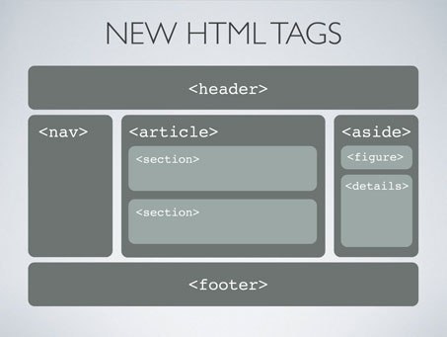
HTML5: New Elements
HTML page structure using new element

Slide 20
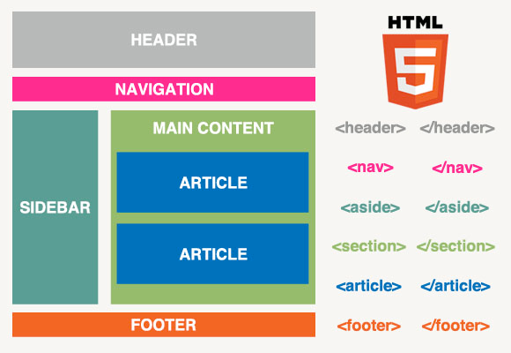
HTML5: New Elements

Slide 21
HTML5: Semantic & Non-Semantic Elements
A semantic element clearly describes its meaning to both the browser and the developer
<form>, <table>, and <article> - Clearly defines its content.
Non-Semantic elements
Examples of non-semantic elements: <div> and <span> - Tells nothing about its content

Slide 22
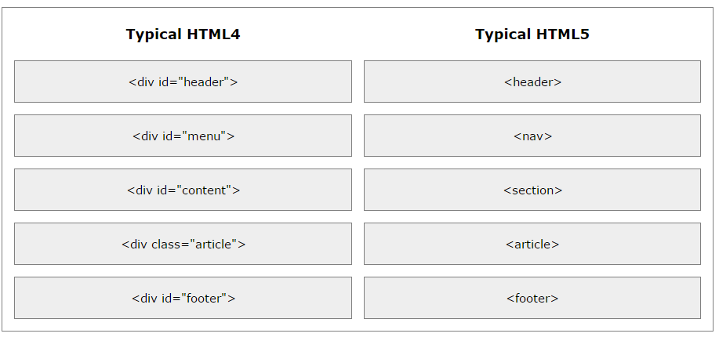
Difference between HTML4 & HTML5

Slide 23
HTML Forms
The HTML <form> element defines a form that is used to collect user input
<form> form elements </form>
This input is received by a form-handler
A server page with script to process form data
Page is specified in form method

Slide 24
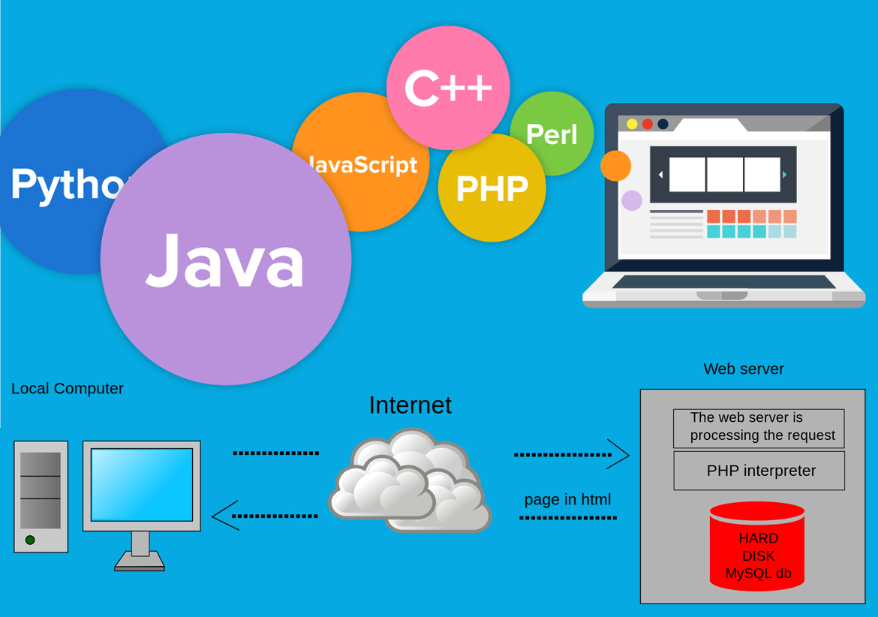
Server Side Scripting languages

Slide 25
HTML Form Elements
The <input> element is the most important form element.
The <input> element can be displayed in several ways, depending on the type attribute.
<input type="text">
<input type=“radio">
<input type=“submit">

Slide 26
HTML Form Elements
The <select> element defines a drop-down list:
<select name="cars"> <option value="volvo“ selected>Volvo</option> <option value="saab">Saab</option> <option value="fiat">Fiat</option> <option value="audi">Audi</option> </select>

Slide 27
HTML Form Elements
The <textarea> element defines a multi-line input field (a text area):
<textarea name="message" rows="10" cols="30"> This is paragraph </textarea>
The <button> element defines a clickable button:
<input type=“submit" />

Slide 28
GET & POST Methods
The method attribute specifies how to send form-data (the form-data is sent to the page specified in the action attribute).
The form-data can be sent as URL variables (with method="get") or as HTTP post transaction (with method="post").

Slide 29
GET & POST Methods
GET
Appends form-data into the URL in name/value pairs
The length of a URL is limited (about 3000 characters)
Never use GET to send sensitive data! (will be visible in the URL)
Post
Appends form-data inside the body of the HTTP request (data is not shown is in URL)
Has no size limitations

Slide 30
<form action="action_page.php“ method=“get”> First name:<br> <input type="text" value=“FirstName"><br> Last name:<br> <input type="text" name="lastname" value=“LastName"><br><br> <input type="submit" value="Submit"> </form>

